Slide 1
WELCOME TO ROTARY
NEW MEMBER ORIENTATION
Notes:
adapted from Rotary District 5500

Slide 2
ORIENTATION MATERIALS
This Is Rotary
The ABC’s of Rotary
You & Your Rotary Foundation
How to Propose a New Member
New Member Checklist
List of Club Officers, Directors, and Committees
Club Bylaws
Paul Harris Fellow Information
Webpage

Slide 3
ROTARY INTERNATIONAL IS …
an international service organization whose stated human rights purpose is to bring together business and professional leaders in order to provide humanitarian services, encourage high ethical standards in all vocations, and to advance good will and peace around the world.

Slide 4
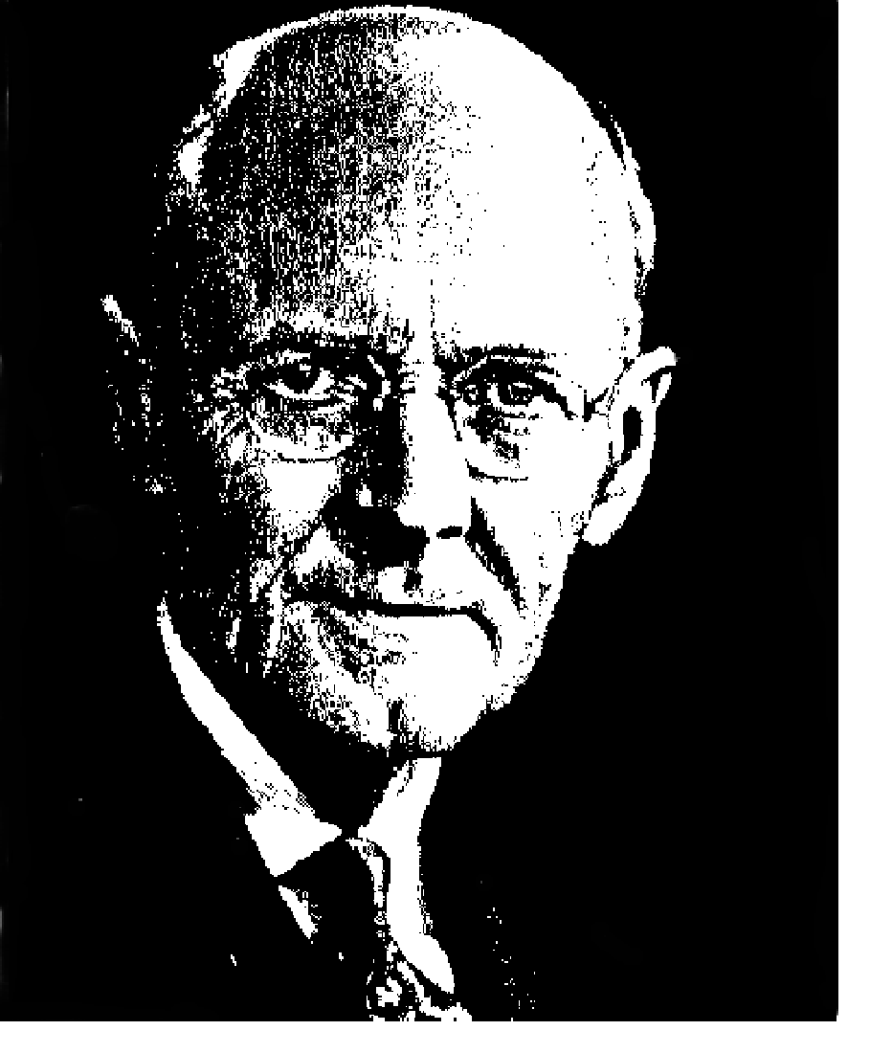
IN THE BEGINNING…
The first Rotary Club was organized in Chicago in 1905 by Paul P Harris
The club, with four members, met in rotation at the offices of the members – thus the name Rotary.
There are approximately 1.2 million members in over 34,000 clubs worldwide.
Rotary Founder
Paul Harris
Notes:
‹#›

Slide 5
SERVICE ABOVE SELF
Rotary was not long to recognize that fellowship alone would not keep a group together - there needed to be a purpose.
Rotary became the world’s first service club. Examples of world-wide service projects
Rotary’s first service project was public restrooms in downtown Chicago, IL.
Rotary, along with our partners, reduced polio cases by 99.9 percent worldwide since our first project to vaccinate children in the Philippines in 1979.
In rural Ghana, Rotary members supply clean water and sanitation facilities to prevent the spread of infectious diseases.
The Rotary Foundation helps bring pre- and postnatal care to mother in rural Haiti.
Nearly 1.4 billion employed people live on less than $1.25 a day. Our members promote economic and community development and reduce poverty in underserved communities through job training, well[paying jobs, and access to financial management institutions.
Notes:
‹#›

Slide 6
ROTARY’S FOUR WAY TEST
Of the things we think, say, or do …
Is it the truth?
Is it fair to all concerned?
Will it build goodwill and better friendships?
Will it be beneficial to all concerned?

Slide 7
GUIDING PRINCIPLES
FIRST: The development of acquaintance as an opportunity for service.
SECOND: High ethical standards: worthiness and dignifying of all occupations
THIRD: Application of the ideal of service to personal, business, and community life
FOURTH: Advancement of international understanding, goodwill, and peace through a united fellowship

Slide 8
Five Avenues of Service
Club Service - Those things that a Rotarian does to help make successful the running of the local club.
Vocational Service - The promoting of the “ideal of service” throughout the business and professional world.
Community Service - Urges every Rotarian to participate in all activities that make the community a better place in which to live.
International Service - Encourages and fosters the advancement of understanding and good will among people of the world.
Youth Service - Recognized the importance of empowering youth and young professional through leadership development programs such as Rotaract, Interact, Rotary Youth Leadership Awards, and Rotary Youth Exchange.
Notes:
‹#›

Slide 9
AN INTERNATIONAL ORGANIZATION
Rotary is made up of four parts:
Heart of Rotary – our local clubs including us!
Rotary International supports Rotary Clubs worldwide by coordinating global programs, campaigns and initiative.
The Rotary Foundation uses generous donations to fund projects by Rotarians and our partners in communities around the world. As a nonprofit, all of the Foundation’s funding comes from voluntary contributions made by Rotarians and friends who share our vision of a better world.
Together, Rotary clubs, Rotary International, and the Rotary Foundation work to make lasting improvements in our communities and around the world.
Notes:
‹#›

Slide 10
ROTARY HIERARCHY
Insert RI President Photo here
Rotary International is governed by a president and a board of directors elected from all over the world.
Insert current theme logo here
RI President Name
Rotary International President YEAR -YEAR
Rotary Club of ____________________
Notes:
‹#›

Slide 11
THE ROTARY FOUNDATION
Notes:
‹#›

Slide 12
PAUL HARRIS FELLOWS & BENEFACTORS
The Rotary Foundation is essential to securing and growing Rotary programs throughout the world. We recognize donors and offer individual and club recognition, as well as naming opportunities that let you honor a friend or family member with a named or endowed gift.
Rotary Foundation Sustaining Member, $100 or more per year to the Annual Fund.
Benefactor, when you include the Endowment Fund as a beneficiary in your estate plans or when you donate $1,000 or more to the fund outright. Benefactors receive a certificate and insignia to wear with a Rotary or Paul Harris Fellow pin.
Paul Harris Fellow, $1,000 or more to the Annual Fund, PolioPlus, or an approved Foundation grant. To recognize someone else as a Paul Harris Fellow, you can give that amount in their name. You are recognized as a Multiple Paul Harris Fellow with each additional gift of $1,000.
Paul Harris Society member, when you give $1,000 or more annually to the Annual Fund, PolioPlus, or an approved Foundation grant.
Notes:
‹#›

Slide 13
DISTRICT 6690 GOVERNORS
District Governor ________________
YEAR to YEAR
Rotary Club of __________________
District Governor Elect _______________
YEAR to YEAR
Rotary Club of ____________________

Slide 14
OUR ROTARY CLUB
CURRENT OFFICERS
President _________________
President Elect _________________
Secretary _________________
Treasurer _________________
Past President _________________
Directors-at-Large – _________________
A new board is elected to take office on 1 July of each year.
All Executive positions in Rotary are one year terms that change on 1 July

Slide 15
A HISTORY OF OUR ROTARY CLUB
Chartered in YEAR
## Current Members
Other information here

Slide 16
ROTARY FEES
Initiation Fee – $_____
Quarterly Dues - $______ includes
District Dues
International Dues
Cost of Breakfasts
Social Events – as attended

Slide 17
ROTARY PROTOCOL: PARTICIPATION
Insert attendance and engagement expectations here.

Slide 18
ROTARY COMMUNICATION
Club Newsletter
District Newsletter
The Rotarian Magazine
Websites:
- Club: ________________
- District http://www.rotary6690.org/
- Rotary International (www.rotary.org)

Slide 19
MY ROTARY
Go to www.rotary.org, go to "For Members" and click on My Rotary or click on My Rotary where ever you see it.
Click on Sign In/Register.
If you are a first time user, click on Create account.
Fill in the Account registration information and click on Continue. If club number is requested we are club ######. Our District is 6690..
You will be informed that an e-mail has been sent to you.
Check your email for the address you provided in step 5. You will receive a message which will ask you to click on the blue link to finalize the process.
Fill in all the mandatory information and click on Create account.
When the screen refreshes you will be given information describing what you can do with the MyRotary account. After reading, click on Continue.

Slide 20
WELCOME TO ROTARY
NEW MEMBER ORIENTATION
Notes:
adapted from Rotary District 5500

